Slide 1
LOGISTICS
INTELLIGENT SYSTEM
A Project proposal by
Kerl Kofi Klu
10658676

Slide 2
TABLE OF CONTENTS
01
02
03
04
THE IDEA OF A SOLUTION
INTRODUCTION
Origin Story , how it started
Using various State of the Art solutions in the process
Loop holes and pain points
Design Brief and Proposed Solution
Deriving my problem statement from loop holes and pain points of SOAs
A solution module that will address loop holes and pain points

Slide 3

INTRODUCTION
GOD EEHH!
KERL
Kerl&Co.
Sylvia
This is me I have a Merch business as a side hustle, and finding a rider and delivery fees are a headache
Joshua,Clive and I also have a business.We send a foos ball game to hall weeks
Sylvia’s Boss wants me to build him an app for his mini Aboboyaa business

Slide 4
THREE TROUBLES ONE SOLUTION

Slide 5



THE IDEA OF A SOLUTION
STATE OF THE ARTS
It is used for food delivery from select resturants through an app
It is a ride hailing system that can sometimes be used to send items
Uses USSD and Partnerships with courier services to find you a rider

Slide 6
LOOP HOOLES AND PAINPOINTS
Ease of Use
Delivery Options
Vehicle Range
Open Market

Slide 7
PROBLEM STATEMENT
There is a need for a software solution that is easy to use , provides users with useful delivery options, has a wide range of vehicles and an open market for courier services.

Slide 8
Design Brief
Design an innovative intelligent Logistics system for small scale courier services doing end to end delivery. A software platform that supports both b2c (business to consumers) and b2b (business to business) processes of courier logistics in a seamless manner.

Slide 9
Intelligence Logistics
Innovative services powered by software designed to drive ease of use, useful delivery options, vehicle range and an affordable couriers service digitization platform.
Intelligence Logistics

Slide 10
OUR SERVICES
Point to Point Delivery-Express
Point to Point-Regular
Grouped Delivery
b2c
From one Specific Destination to another.
From specific desitations to other specific destinations
From one general destination to another
Easy Startup
Driver Recruitment
Logistics Management
b2b
Seamless business integration or kickstart with a wide vehicle range
Finding drivers for partnerships made easy
Dashboard that makes managing logistic data easy

Slide 11
Point to Point Delivery-Express
ADWOA
From one Specific Destination to another. From one sender to one recipient .
AMA

Slide 12
Point to Point-Regular
NAA
ESI
YAA
From specific desitations to other specific destinations. From a number of senders in one pickup point to respective destinations
ABA
AWO
MAY

Slide 13
Grouped Delivery
From one general destination to another. A group of senders pick slots and send their items to a pick up point to be transported to another pick up point. Where recipients can pick up items

Slide 14
Easy Startup
Seamless business integration or kick start .Whether you are an already existing courier service looking to expand your reach or a start up all you need to do is sign up.

Slide 15
Driver Recruitment
Finding drivers for partnerships made easy. Drivers looking to partner with courier companies and courier companies looking to for driver can now meet easily.

Slide 16
Logistics Management
Dashboard that makes managing logistic data easy. With our algorithms and Intuitive UI sorting out orders and deliveries is easy.

Slide 17
TWO PLATFORMS
Mobile Application
Web Application
For customers and drivers
For courier services.

Slide 18
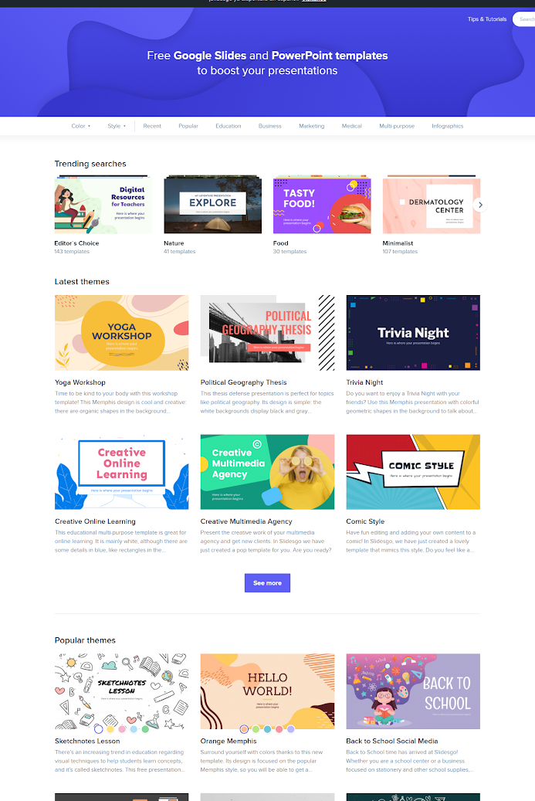
MOBILE APP
Customers can easily get their item delivered to destinations by a wide range courier services with all sorts of vehicles at affordable delivery options. Drivers also receive and accept user request through a similar app

Slide 19
WEB APP
Courier services can signup, optimize their business, easily manage logistics and access a pool of drivers and resources from the web app.

Slide 20
FOR YOUR CONSIDERATION
LOGISTICS INTELLIGENCE
Innovative services powered by software designed to drive ease of use,
delivery options, vehicle range and an affordable couriers service digitization platform.
BY KERL KOFI KLU
ID:10658676
THANK YOU

